Slide 1
Proclamation Poster

Slide 2
Unlike other larger, more complex mediums, the poster is generally a simple attempt to attract attention and communicate basic information about an event or a product.

Slide 3
Proclamation Poster Rubric:
TOPIC TITLE
Student name
Teacher name
Period (Block)

Slide 4
Product: Be specific
Research Topic: Clearly Stated
Visual image related to project (no more than two)

Slide 5
You can use Microsoft Word or
PowerPoint to create your poster.
You can create your poster by hand and scan it into a document.

Slide 6
Design Suggestions
Use all the space at your disposal, but do not cram in the content - white space is an important part of the layout, and good use of it can make a poster elegant and arresting.

Slide 7
COLOR
Use color sparingly - limited use of a few colors is more striking than a 'rainbow' approach.
Think about why you are using color; it is especially useful for emphasis and differentiation.

Slide 8
Avoid color combinations that clash (e.g. red on blue)
Use white or muted color background (e.g. pastel shades) WITH A DARK FONT.

Slide 9
Font
Choose a clear font with large inner space
(i.e. the space inside the loops of letters such as 'o', 'd', 'p').
Good examples are Arial, Verdana, Georgia or Helvetica.

Slide 10
Keep the word count as low as possible.
The title text should be readable from 4 – 5 yards away (50 PT. FONT)
All other print should be readable from 2 yards away - at least (30-point text

Slide 11
Keep Your Balance
Asymmetrical balance is based on equal eye attraction, which occurs when dissimilar
objects are balanced so that they are equally interesting to the eye.

Slide 12
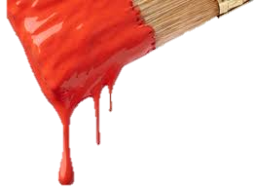
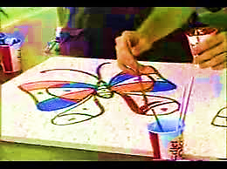
Robert Chupula
Hospital Art
Program
Research:
Art programs designed to give comfort and hope to those who suffer in hospitals by creating artwork with patients.
Product:
Design, Create, and Implement a mural project for Cobb General Hospital’s Pediatrics ward.
Mr. Picasso
3rd Block

