Slide 1
The Senior Project Resume

Slide 2
Why Make a Resume?
Usually, a resume is a one-page summary used to attempt to “sell” yourself as a candidate for employment.
For the senior project, your resume will be used to simply introduce yourself to the judges. They want to know your achievements, successes, interests, and experience.

Slide 3
Why Make a Resume?
For the senior project, your resume should all fit onto one page, and should look similar to this:

Slide 4
How Will It Be Graded?
You will receive a grade for your resume, which will be graded by the SENIOR PROJECT RESUME COMMITTEE.
Your English teacher will give you these submission deadlines.

Slide 5
What Is Included in a Resume?
In a real resume, you would want to highlight specifically those skills and experiences that an employer would find valuable.
Know that this resume will be slightly different.
Here are the categories that you may want to include on your ONE-PAGE document: PROFILE, EDUCATION, ACHIEVEMENTS, INTERESTS, and WORK EXPERIENCE.
You will also need to include THREE REFERENCES.

Slide 6
The Profile
The most difficult and time-consuming part of a resume is the PROFILE. This section used to be called the “Objective” years ago.
In a PROFILE STATEMENT, you will speak of yourself in 3rd person, but will NOT use pronouns.
Instead of saying, “I enjoy playing volleyball and golf,” you would begin the fragment with: “Enjoys playing volleyball and golf.”
Instead of saying, “He is a highly-energetic student who desires to succeed in academics,” remove pronouns and state: “A highly-energetic student desiring to succeed in academics.”
Go online and search for resume profile statements for students.

Slide 7
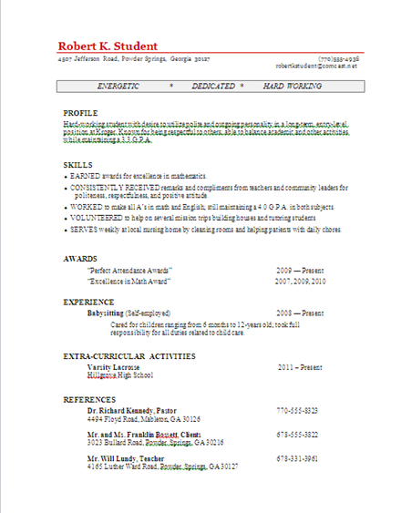
Skills
Have a bulleted list of fragments (do not use “I”) of your things you have done or do that should be highlighted
Try to begin each fragment with a verb, like “EARNED,” “RECEIVED,” “VOLUNTEERS,” etc.
Good examples include:
EARNED all A’s in math
VOLUNTEERS at local church food bank
TAUGHT lessons to elementary students

Slide 8
AWARDS
If you have awards you have received since 9th grade, have a bulleted list of fragments of your awards that should be highlighted
Do not use “I”
Good examples include:
Perfect Attendance Award, 2011
“Most Improved Player,” Hillgrove Basketball, 2010
Principal’s Honor Roll, 2010 - Present

Slide 9
EXPERIENCE
If you have work experience, add a bulleted list of fragments (do not use “I”) of jobs that should be highlighted. Yes, it is fine to include babysitting, mowing lawns, etc.
Begin with the job title. Then, include general dates, employer, and a description fragment.
Follow this format:
Cashier 2011-Present Chick-fil-A, Marietta, GA Professionally greets customers and fills orders while maintaining accurate cash drawer

Slide 10
EXTRA-CURRICULAR ACTIVITIES
If you participate in activities outside of school academics, list them here. Make a bulleted list of fragments (do not use “I”) of your extra-curricular activities.
Here are some examples:
Hillgrove Lacrosse 2010 – Present
East Cobb Baseball 2010 – 2011

Slide 11
REFERENCES
Include three complete references of people who have supervised you and would speak highly of you. These may include teachers, community leaders, employers, coaches, etc. DO NOT include family members.
You must include name, address, and contact number

Slide 12
REFERENCES
Here is an example:
Rev. Charles Mingonet* 4934 Concord Road, Smyrna, GA 30082 678-555-8912 Art Carlson* 2931 Cumberland Parkway, Atlanta, GA 30339 770-555-9087 Mr. Michael Tydings** 4165 Luther Ward Road, Powder Springs, GA 30127 678-331-3961
*Always ask someone for permission to list them as a reference.
**For teachers, use the school address and phone number.

Slide 13
NOW
You should be ready to begin working on your PROFILE STATEMENT.

